Slide 1
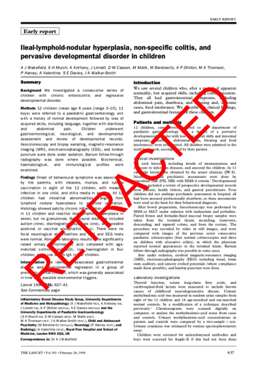
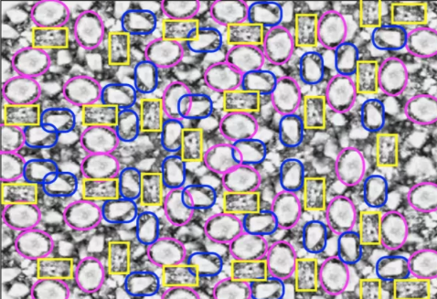
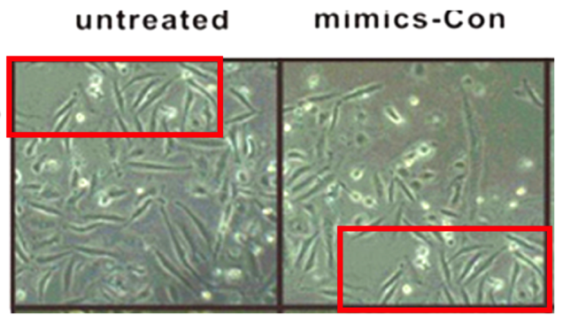
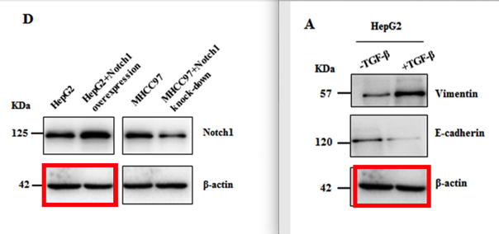
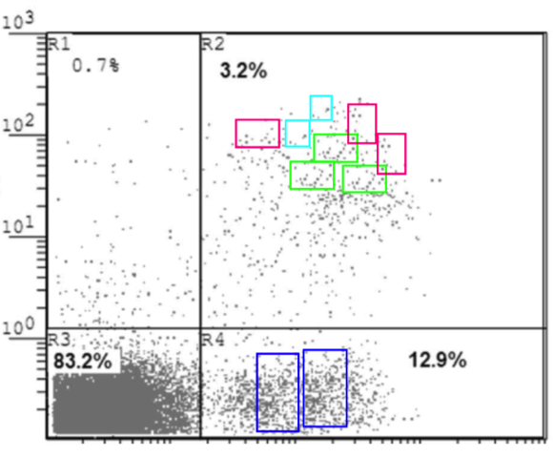
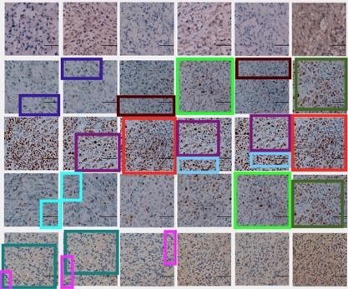
Inappropriate Image Duplications in Biomedical Publications
Elisabeth Bik
www.ScienceIntegrityDigest.com
Twitter: @MicrobiomDigest
Financial disclosures:
I receive consulting and speaker fees
I receive donations through Patreon.com
uBiome founders charged with insurance fraud

Slide 2
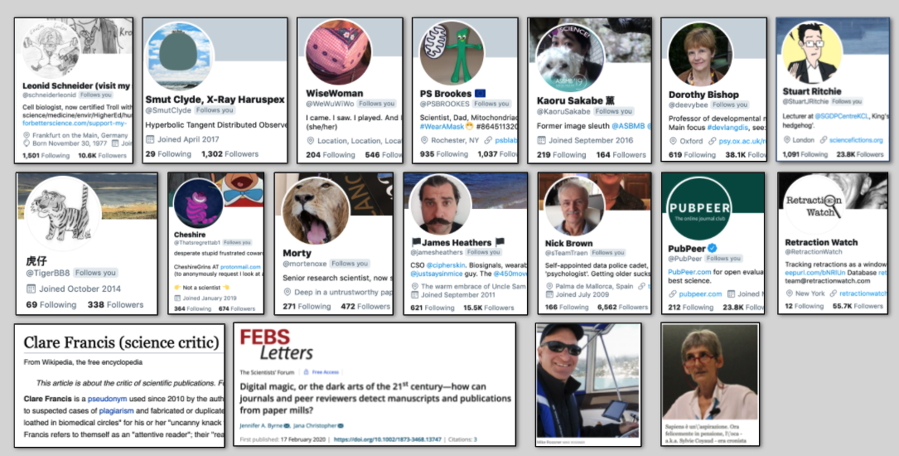
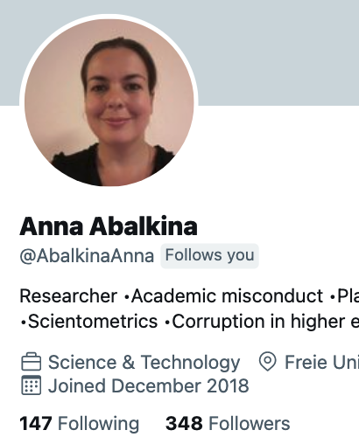
Many science critics and platforms

Slide 3
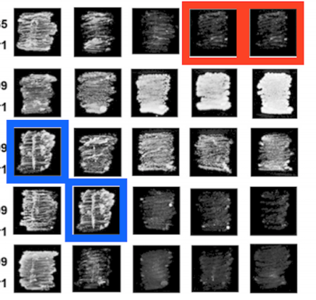
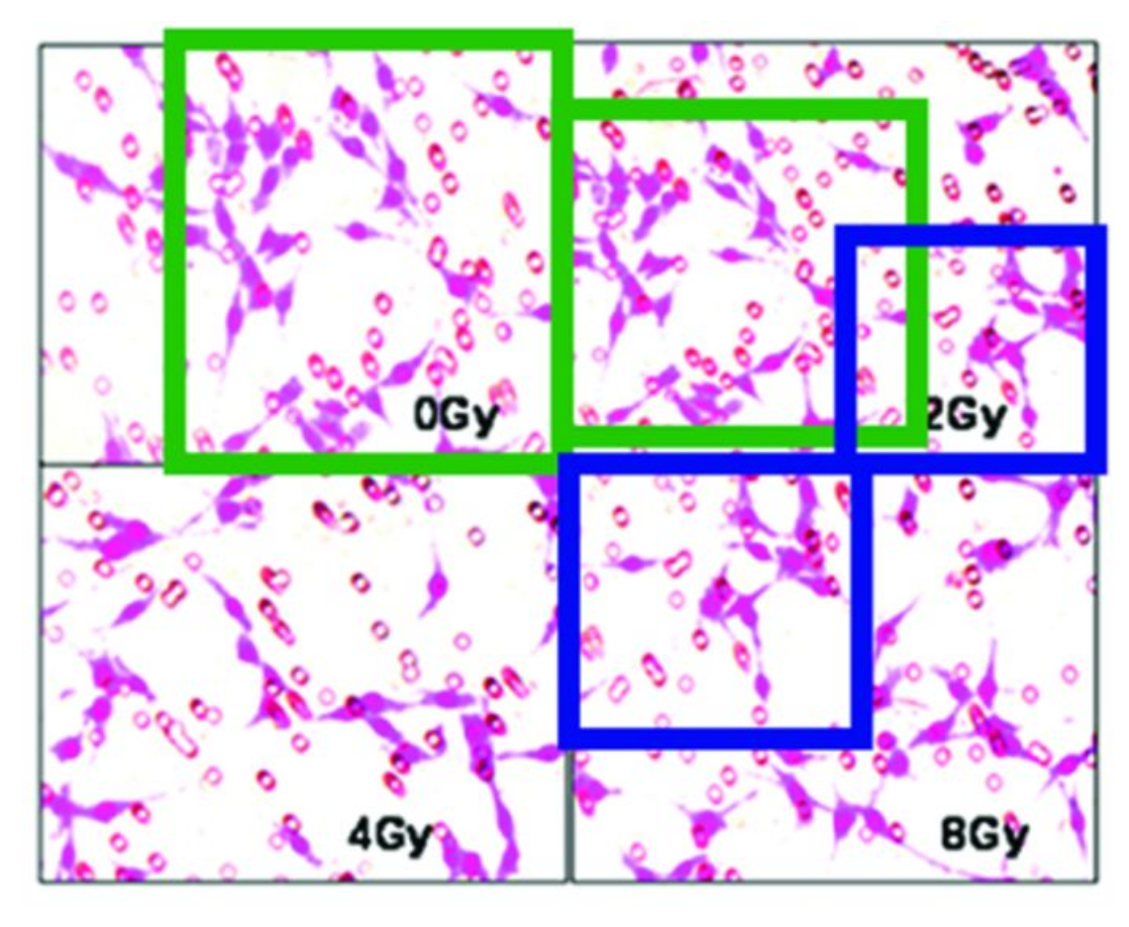
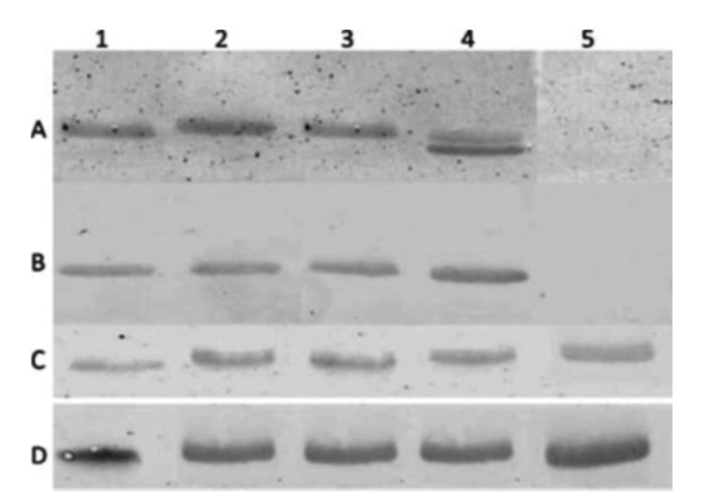
Inappropriate image duplication
I: Simple
II: Repositioned
III: Alteration
DOI: 10.1128/MCB.00773-15
DOI: 10.1371/journal.pone.0098448
DOI: 10.1111/j.1469-0691.2011.03607.x
Honest error
Deliberately

Slide 4
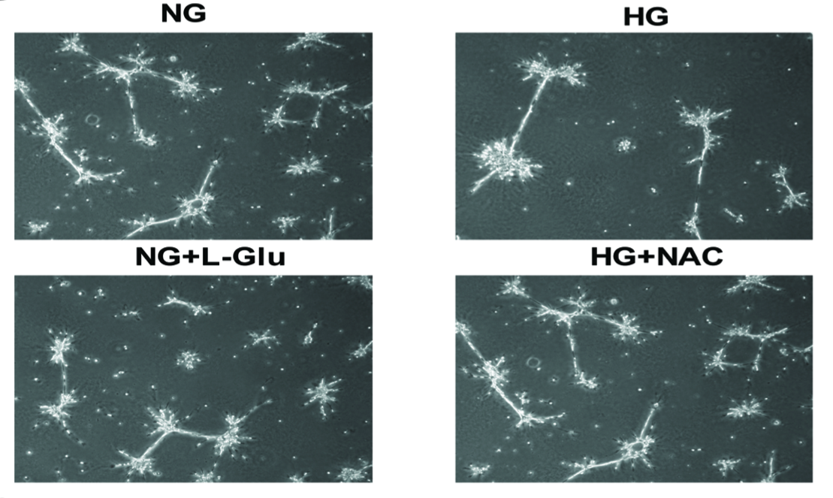
Type I: Simple Duplication - honest error
Effect of diabetes on retinal astrocytes
University of Wisconsin School of Medicine and Public Health, USA
PLOS ONE (2014), DOI: 10.1371/journal.pone.0103148
Reported to journal: October 2015. No action yet.

Slide 5
Type I: Simple Duplication - honest error
Effect of diabetes on retinal astrocytes
University of Wisconsin School of Medicine and Public Health, USA
PLOS ONE (2014), DOI: 10.1371/journal.pone.0103148
Reported to journal: October 2015. No action yet.

Slide 6
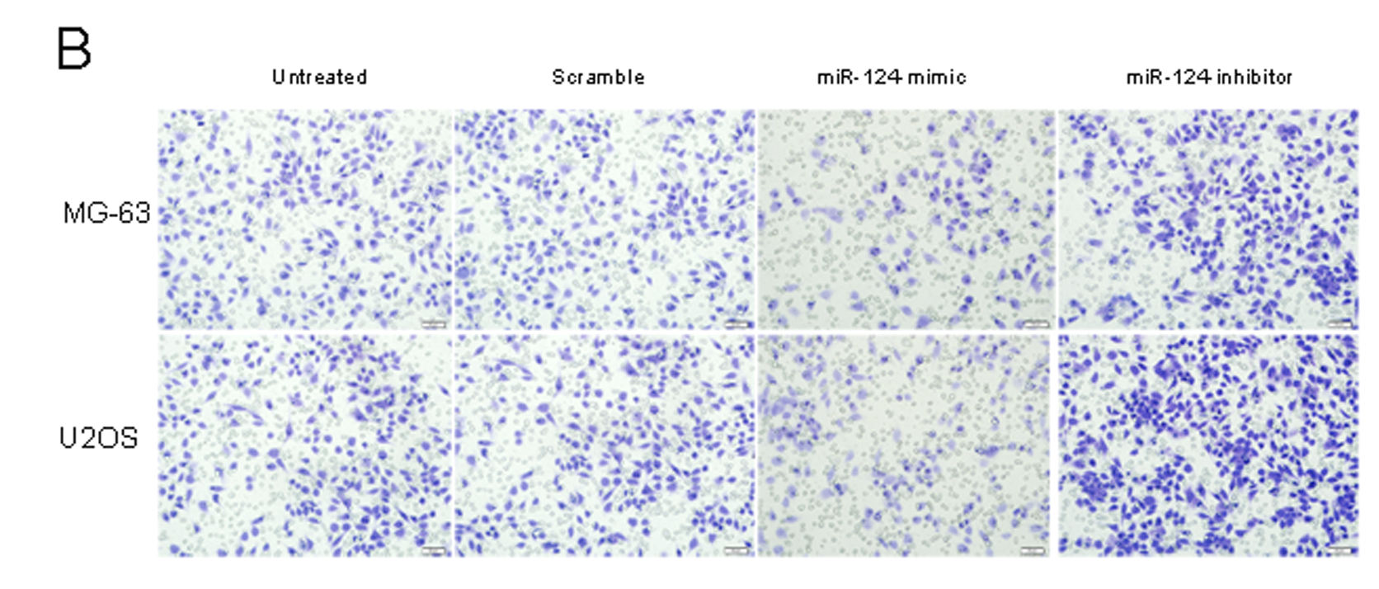
Type II: Duplication with repositioning
Harbin Medical University, China
PLOS ONE (2014) - DOI: 10.1371/journal.pone.0091566
Reported Oct 2015, retracted March 2019

Slide 7
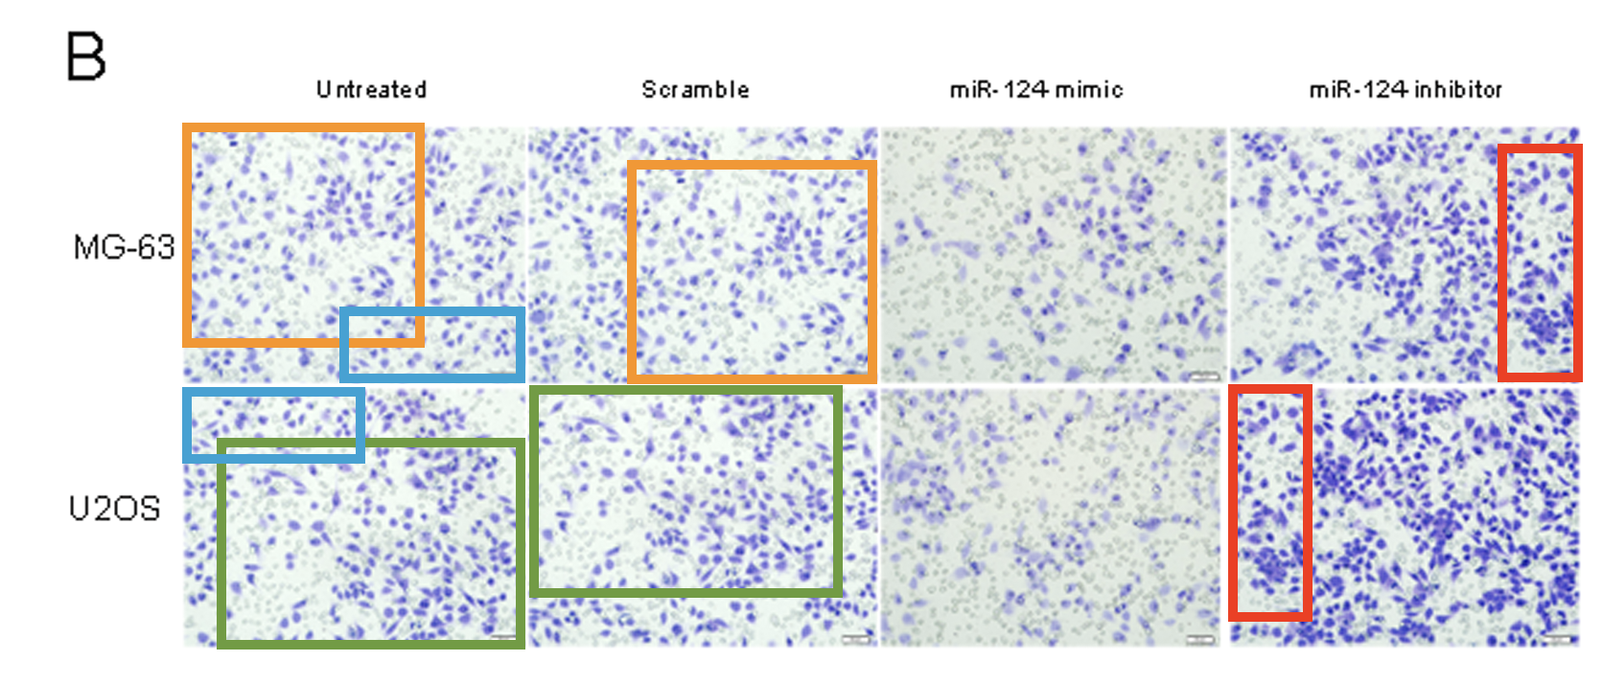
Type II: Duplication with repositioning
Harbin Medical University, China
PLOS ONE (2014) - DOI: 10.1371/journal.pone.0091566
Reported Oct 2015, retracted March 2019

Slide 8
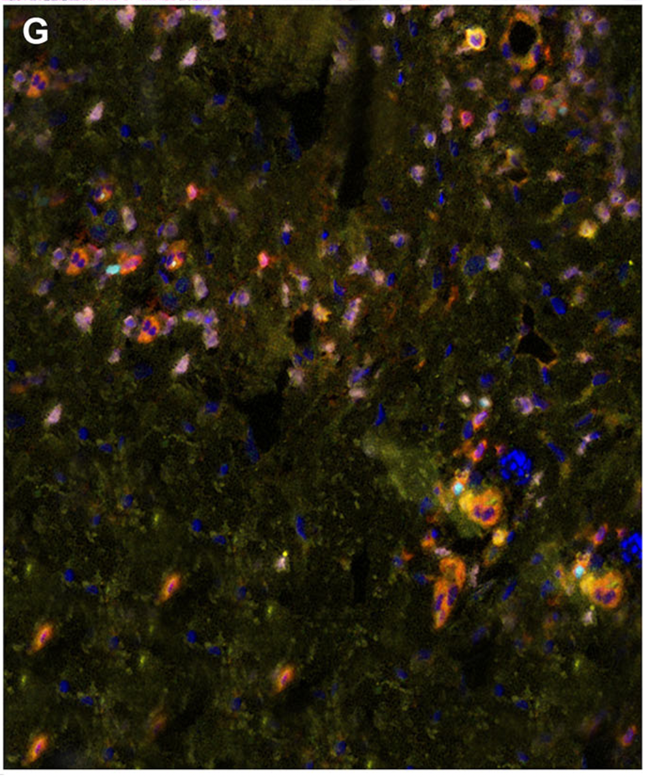
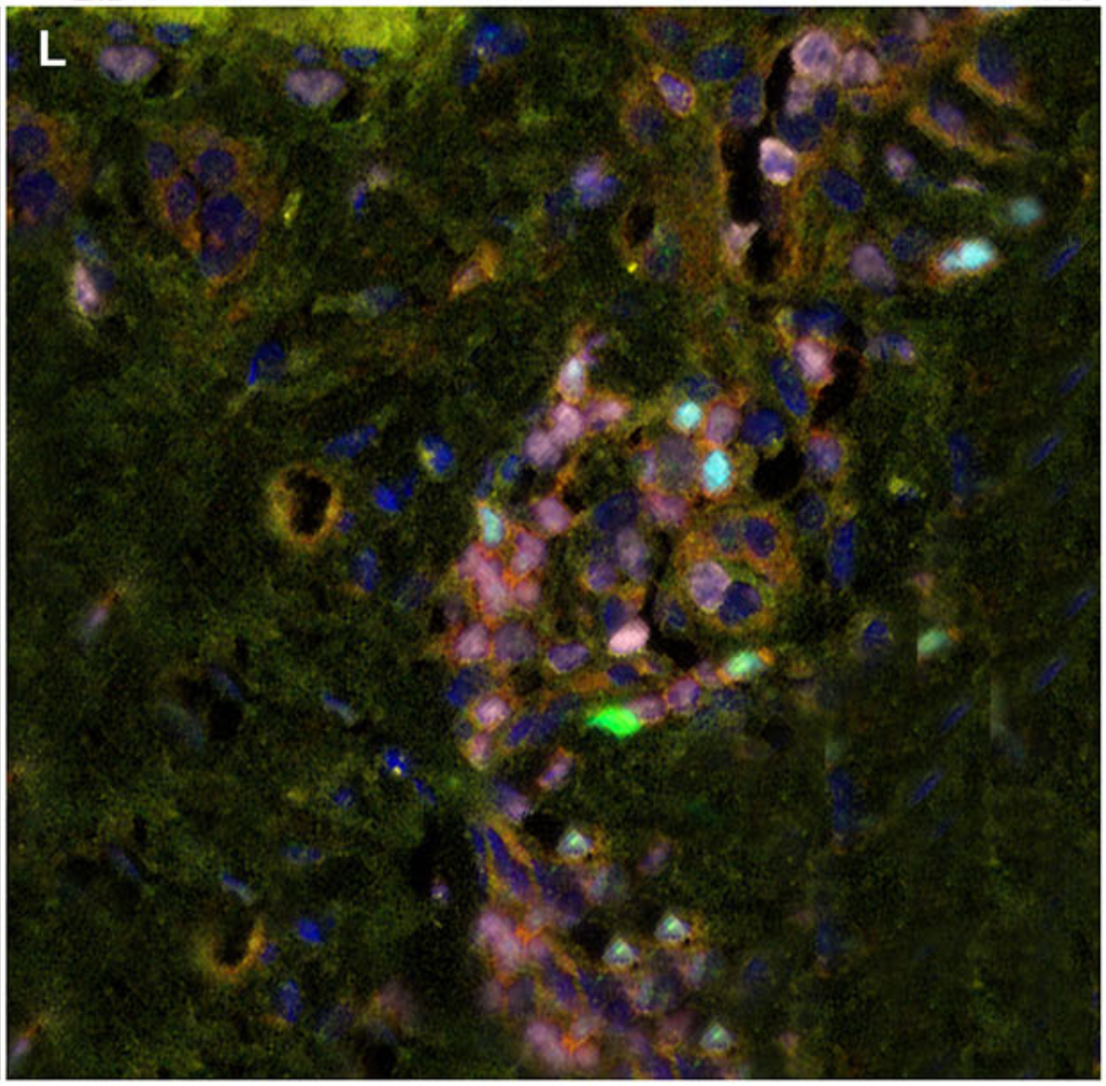
Type III: Duplication with alteration
University of Texas MD Anderson Cancer Center, Houston, TX
Frontiers in Oncology (2021), DOI: 10.3389/fonc.2021.621591.
Reported on PubPeer June 2023

Slide 9
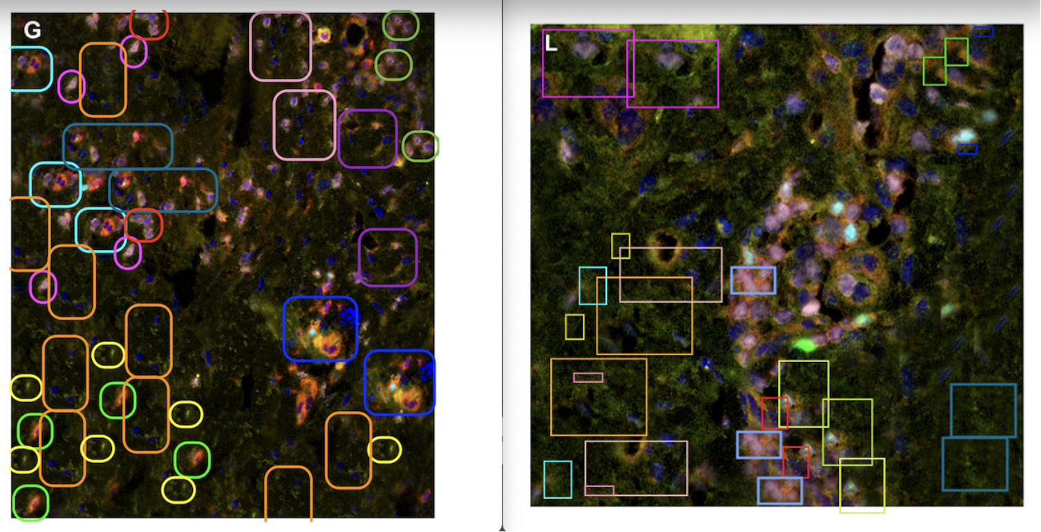
Type III: Duplication with alteration
University of Texas MD Anderson Cancer Center, Houston, TX
Frontiers in Oncology (2021), DOI: 10.3389/fonc.2021.621591.
Reported on PubPeer June 2023

Slide 10
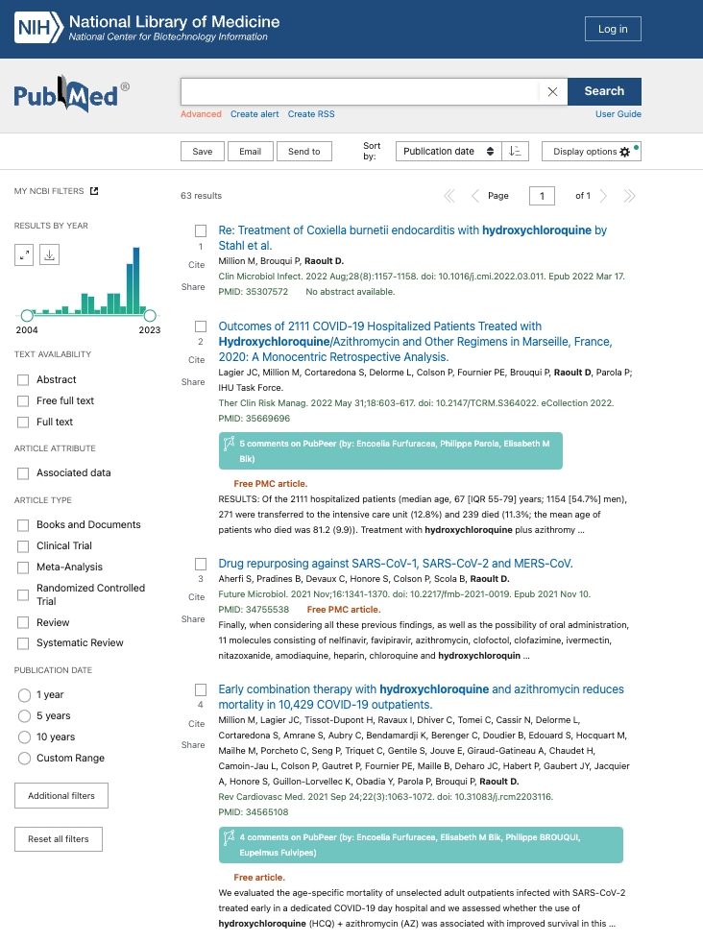
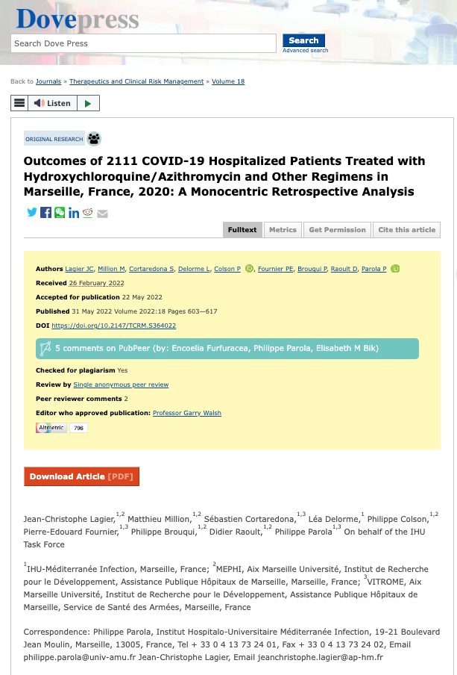
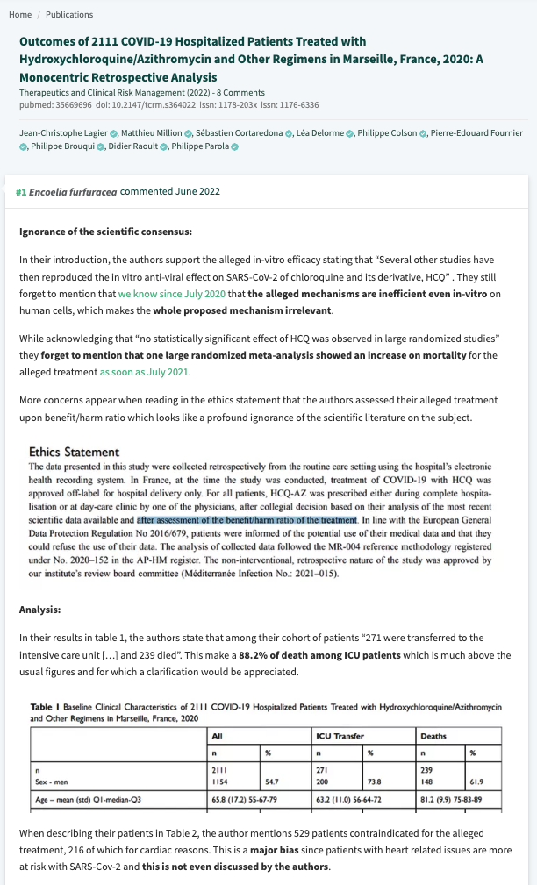
Use PubPeer to check for concerns
PubMed search
Journal website
PubPeer post

Slide 11
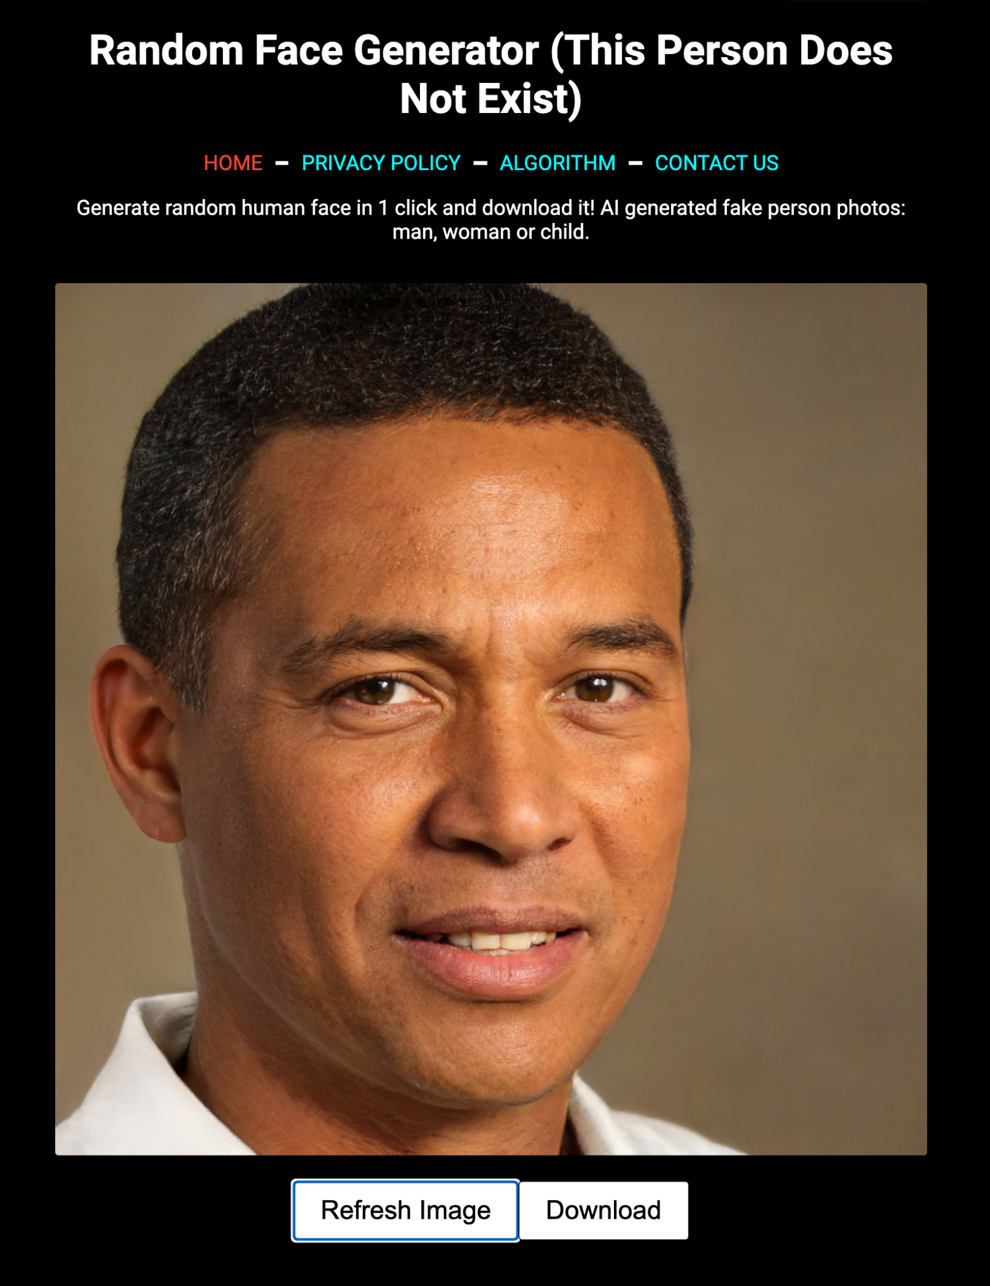
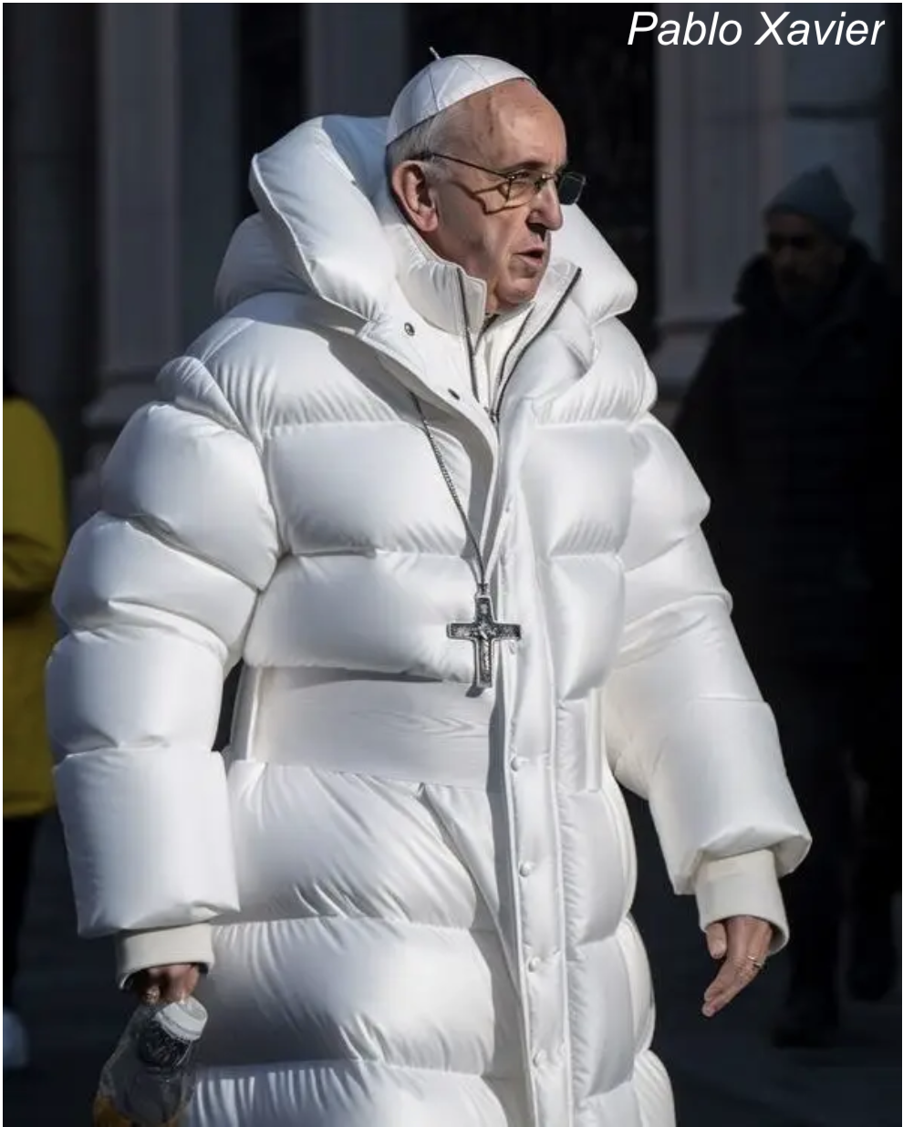
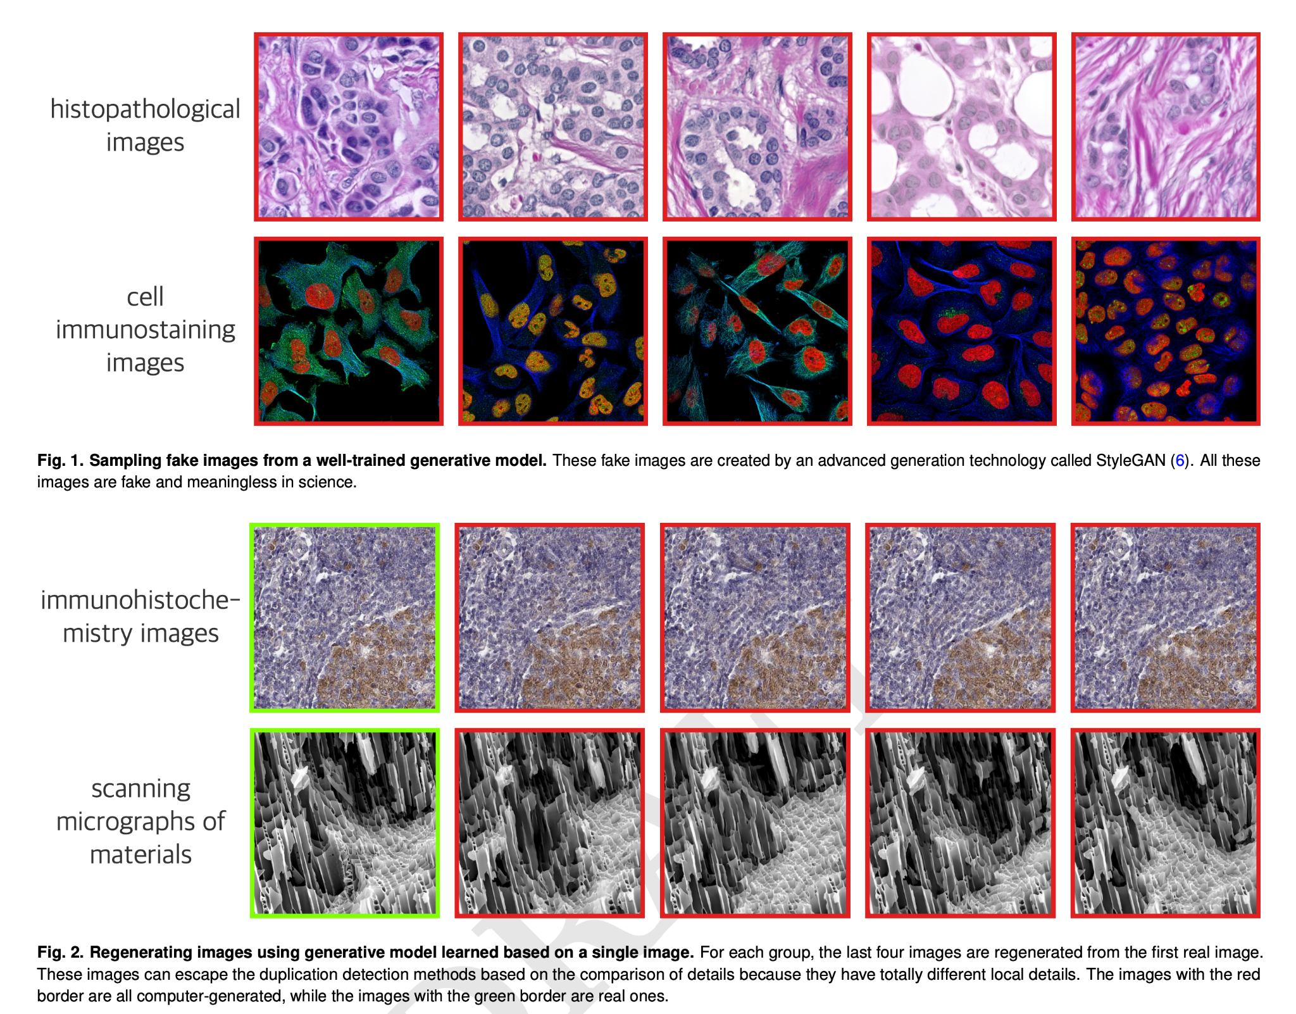
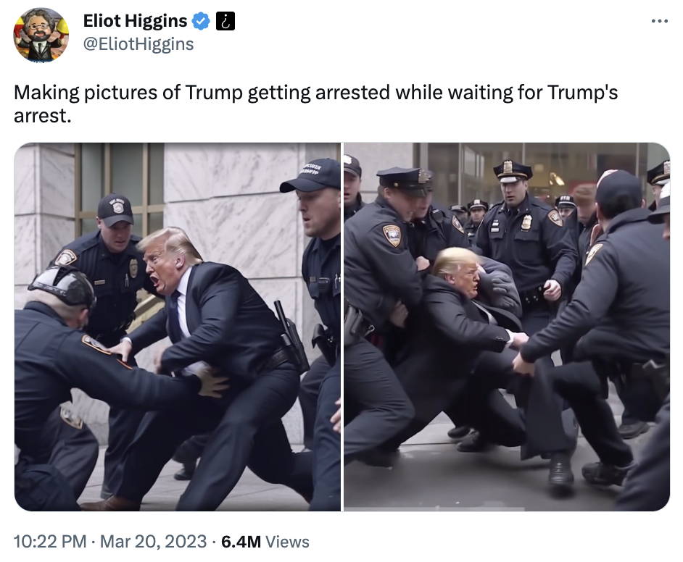
Gen Artificial intelligence - fake text, images, data

Slide 12
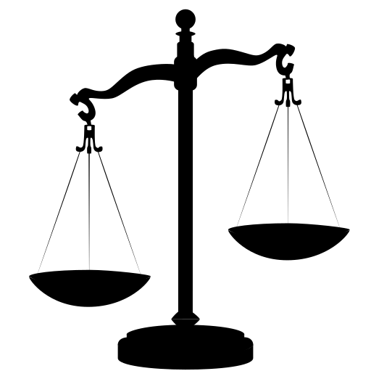
The imbalance of research misconduct
Big rewards
Faster, easier experiments
Results look better
More chance getting grants
Easier to publish
Higher IF, more citations
Success, respect
Few consequences
Few corrections /retractions
Institutional investigations take years, rarely action
Senior researchers rarely held accountable
ORI / NSF sanctions mild
Notes:
You have to wonder what Traffic and Sports would look like if there were no speed limits or rules about doping use.

