Slide 1
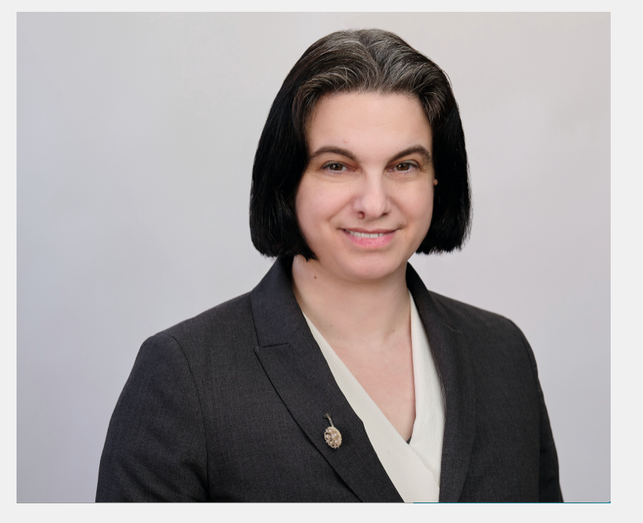
Eugenie Reich June 15, 2023 Shorenstein Center Journalists’ Resource

Slide 2
Science
Reporter
1999 – 2015
Whistleblower
Lawyer
2018 – today

Slide 3
What is a court docket?
A formal record of everything filed in a lawsuit
Where can I find court dockets?
http://www.pacer.gov
https://www.masscourts.org/eservices/home.page.2
https://forms.mad.uscourts.gov/courtlist.html https://masscourts.org/reports/DailyList_Site1176.pdf
Where can I find court calendars?

Slide 4
A Simple Docket
United States District Court District of Massachusetts (Boston) CIVIL DOCKET FOR CASE #: 1:09-cv-10883-NMG
Pro Tip: “Motion to Dismiss” determines legal viability, not factual reliability.
Reich v. U.S. Department of Energy et al Assigned to: Judge Nathaniel M. Gorton
Nature of Suit: 895 Freedom of Information Act Jurisdiction: U.S. Government Defendant
Date Filed: 05/27/2009 Date Terminated: 08/22/2011 Jury Demand: None Date Filed: 05/27/2009 Date Terminated: 08/22/2011 Jury Demand: None
05/27/2009 | 1 | COMPLAINT against U.S. Department of Energy, Oak Ridge National Laboratory, UT-Battelle, filed by Eugenie Samuel Reich. (Attachments: # 1 Civil Cover Sheet and Category Form)(Paine, Matthew) (Additional attachment(s) added on 5/27/2009: # 2 Exhibit - 1, # 3 Exhibit - 2, # 4 Exhibit - 3, # 5 Exhibit - 4, # 6 Exhibit - 5, # 7 Exhibit - 6, # 8 Exhibit 7 - Part 1, # 9 Exhibit 7 - Part 2, # 10 Exhibit 7 - Part 3, # 11 Exhibit 7 - Part 4, # 12 Exhibit - 8, # 13 Exhibit - 9, # 14 Exhibit - 10, # 15 Exhibit - 11) (Paine, Matthew). (Entered:
07/02/2009 | 13 | MOTION to Dismiss by UT-Battelle. (Attachments: # 1 Text of Proposed Order)(Martinescu, Julia) (Entered: 07/02/2009)

Slide 5
A Simple Docket (cont.)
06/28/2010 | 35 | MOTION for Summary Judgment by Oak Ridge National Laboratory, U.S. Department of Energy.(Grady, Mark) (Entered: 06/28/2010)
06/28/2010 | 36 | Statement of Material Facts L.R. 56.1 re 35 MOTION for Summary Judgment filed by Oak Ridge National Laboratory, U.S. Department of Energy. (Attachments: # 1 Affidavit Exhibit 1 - Moore Declaration, # 2 Affidavit Exhibit 2 - Roberto Declaration, # 3 Exhibit Exhibit 2A - Roberto Declaration Exhibit 1, # 4 Affidavit Exhibit 3 - Dehmer Declaration, # 5 Affidavit Exhibit 4 - Rothrock Declaration, # 6 Exhibit Exhibit 4A - Rothrock Declaration Exhibit 1, # 7 Exhibit Exhibit 4B - Rothrock Declaration Exhibit 2, # 8 Exhibit Exhibit 4C - Rothrock Declaration Exhibit 3, # 9 Exhibit Exhibit 4D - Rothrock Declaration Exhibit 4, # 10 Exhibit Exhibit 4E - Rothrock Declaration Exhibit 5, # 11 Exhibit Exhibit 4F - Rothrock Declaration Exhibit 6, # 12 Affidavit Exhibit 5 - Kung Declaration)(Grady, Mark) (Entered: 06/28/2010)
06/28/2010 | 37 | AFFIDAVIT in Support re 35 MOTION for Summary Judgment filed by Oak Ridge National Laboratory, U.S. Department of Energy. (Attachments: # 1 Affidavit Exhibit 8 - Lincoln Declaration, # 2 Affidavit Exhibit 9 - Angulo Declaration)(Grady, Mark) (Entered: 06/28/2010)
06/28/2010 | 38 | MEMORANDUM in Support re 35 MOTION for Summary Judgment filed by Oak Ridge National Lab
08/19/2011 | 81 | Judge Nathaniel M. Gorton: ORDER entered. MEMORANDUM AND ORDER "In accordance with the foregoing, defendants' motion for summary judgment (Docket No. 35 ) is ALLOWED and defendants' motion to strike (Docket No. 78 ) is DENIED." (Duong, Diep) (Entered: 08/22/2011)
08/19/2011 | 82 | Judge Nathaniel M. Gorton: ORDER entered. JUDGMENT for the Defendants (Duong, Diep) (Entered: 08/22/2011)

Slide 6
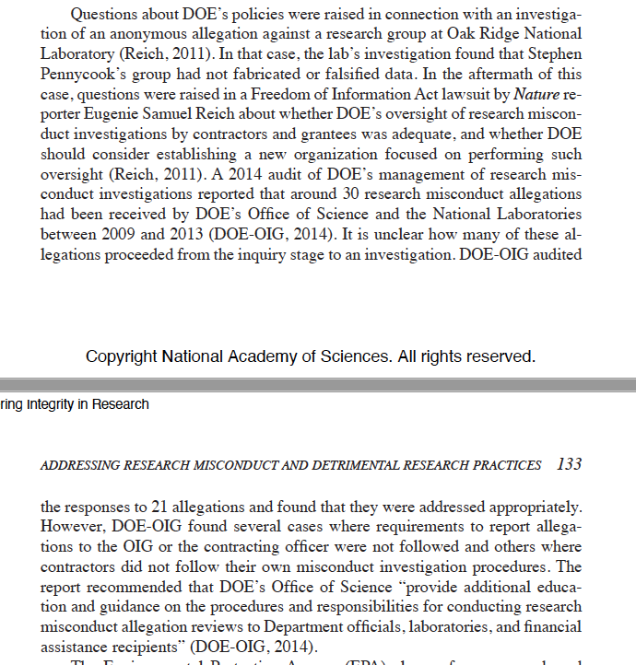

Slide 7
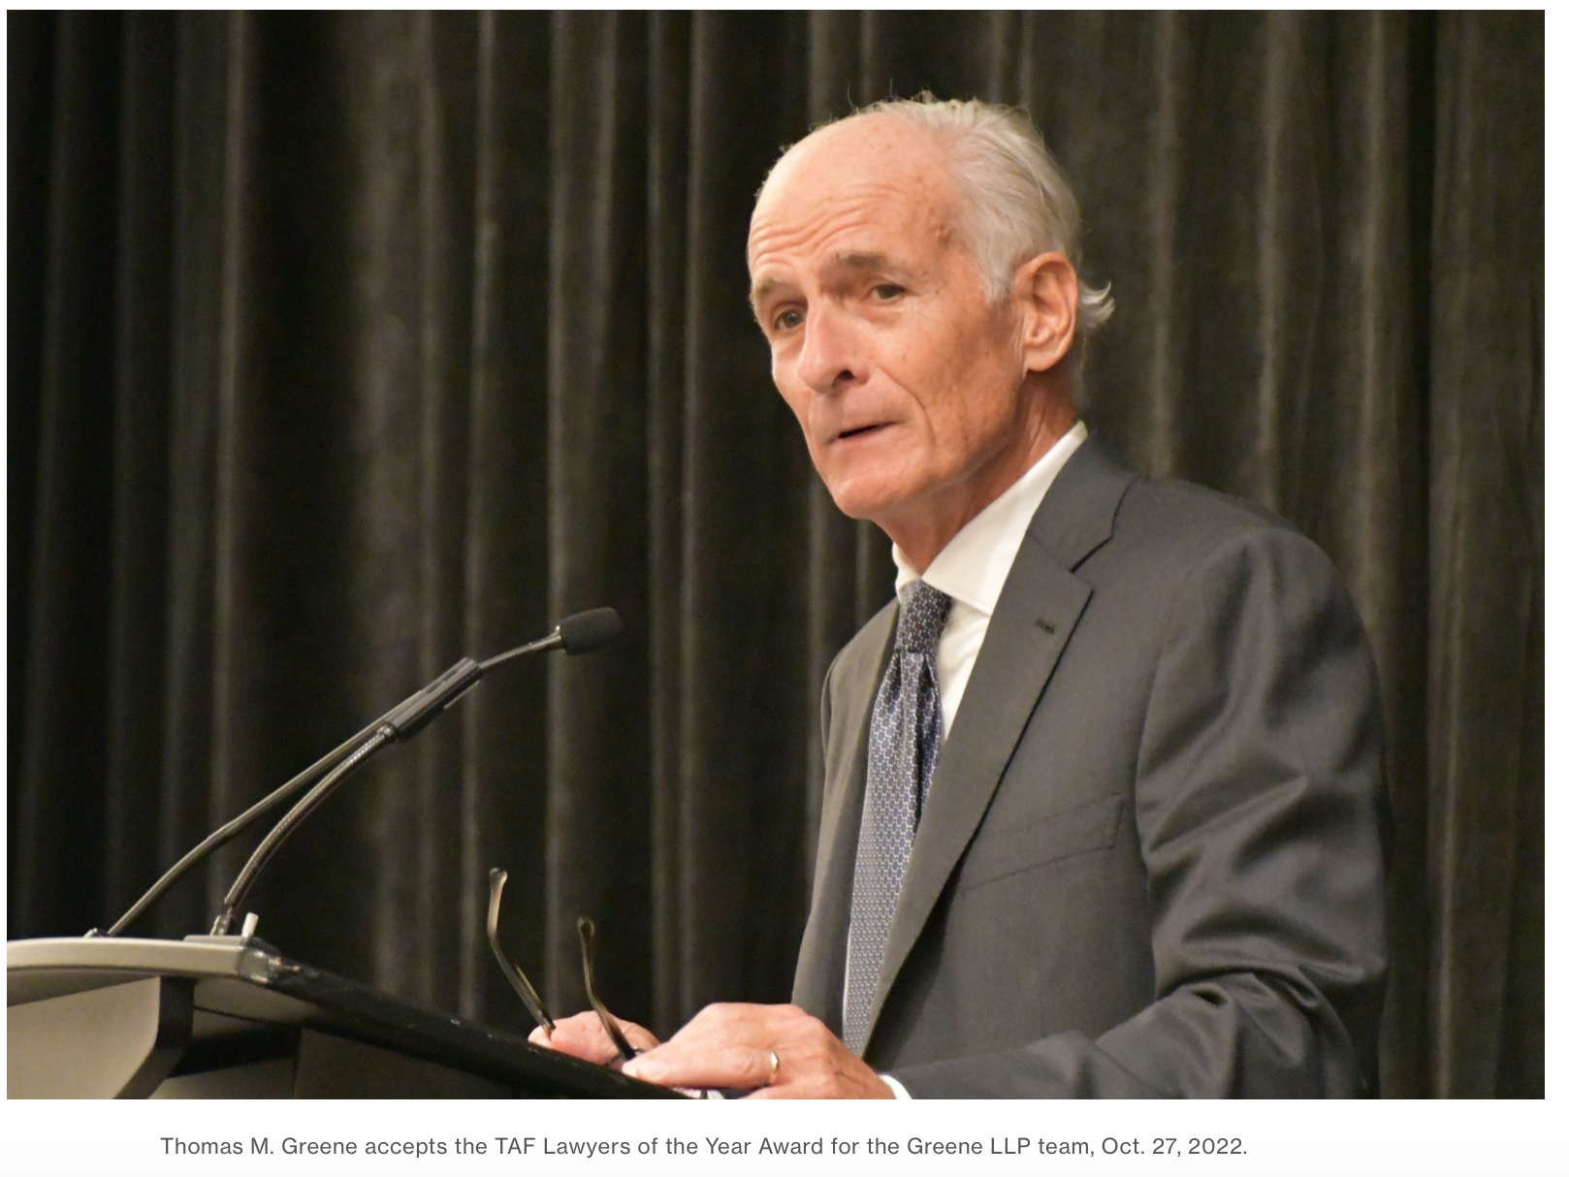
A Complex Docket: USA ex rel. Michael Bawduniak v. Biogen Idec

Slide 8
A Complex Docket
United States of America et al v. Biogen Inc. Date Filed: 04/04/2012 Assigned to: Judge Indira Talwani Cause: 31:3729 False Claims Act Jury Demand: Both Nature of Suit: 375 Other Statutes: False Claims Act Jurisdiction: Federal Question
07/06/2015 | 69 | Judge Indira Talwani: ORDER entered. Order to Unseal Case. See attached Order. (MacDonald, Gail) (Entered: 07/08/2015)
Pro Tip: Entire cases or individual documents within cases can be sealed, but many seals are temporary.
Case Filed April 4, 2012, DOJ Press Release: September 26, 2022

Slide 9
Pro Tip: Look For Scheduling Orders To Know When To Check Dockets For Updates
10/01/2018 |  | Electronic Clerk's Notes for proceedings held before Judge Indira Talwani: Scheduling Conference held: Case called. Court has colloquy with counsel. Parties to jointly report to clerk any request for ADR. Motion for Leave to file amended pleading may be filed; response due 2 weeks after filing; reply only filed w/leave of court. Fact Discovery shall be complete 8/1/19. Monthly status conferences to be set on Wednesdays at 2:00 p.m. and will be subject to change; counsel may appear by telephone if granted leave of court. Scheduling Order to follow. Status Conferences (subject to change) set for 2:00 PM on: 11/14/2018; 12/19/2018; 1/16/2019; 2/13/2019; 3/13/2019; 4/17/2019; 5/15/2019; 6/12/2019; 7/17/2019; and, 8/14/2019, in Courtroom 9 before Judge Indira Talwani. (Attorneys present: Greene, Greene, Tabb, Loucks, Mayer) (MacDonald, Gail) Modified on 10/4/2018 to include conf. type (MacDonald, Gail). (Entered: 10/02/2018)

Slide 10
Discovery Opens: Exchange of Documents
01/04/2019 | 207 | Joint MOTION for Protective Order (Stipulated) and to Enter Proposed ESI Order by Biogen Idec Inc..(Mayer, Kirsten) [ continues … ]
Pop Quiz: Why would the two sides in a litigation agree that information they exchange should remain confidential?
a) Lawyers always want to keep things confidential
b) It makes document exchange go faster
c) It prevents prejudicial publicity
Case Filed April 4, 2012, DOJ Press Release: September 26, 2022

Slide 11
Partial Summary Judgment
12/01/2021 | 477 | MOTION for Partial Summary Judgment by Michael Bawduniak. (Attachments: # 1 Exhibit PEP event payment data, # 2 Exhibit Tier 1 Neurologist event payment data)(Greene, Thomas) (Attachment 1 and 2 replaced on 12/17/2021 with full documents provided by counsel) (Currie, Haley). (Entered: 12/01/2021)
01/28/2022 | 495 | AFFIDAVIT of Eugenie Reich in Support re 477 MOTION for Partial Summary Judgment filed by Michael Bawduniak. (Attachments: # 1 Exhibit 62 - Excerpts of Michael Jones Transcript - 07.10.2020, # 2 Exhibit 63 - 2010 San Francisco Business Plan Excerpt, # 3 Exhibit 64 - 2009 Kansas City Business Plan with Notes, # 4 Exhibit 65 - 2010 Northern Plains Program Plan, # 5 Exhibit 66 - Metadata for BIIB-00290331, # 6 Exhibit 67 - Jereb CID transcript excerpts)(Greene, Thomas) (Entered: 01/28/2022)
Pro Tip: Lawyers support and oppose motions to the Court with affidavits attaching relevant evidence.

Slide 12
Motions in Limine
03/01/2022 | 497 | MOTION in Limine To Exclude The Expert Testimony of Eric Gaier by Michael Bawduniak.(Greene, Thomas) (Entered: 03/01/2022)
03/01/2022 | 498 | MOTION in Limine o Exclude The Expert Testimony of Nathan Basseen by Michael Bawduniak.(Greene, Thomas) (Entered: 03/01/2022)
03/01/2022 | 499 | MOTION in Limine o Exclude The Expert Testimony of Maria Houtchens by Michael Bawduniak.(Greene, Thomas) (Entered: 03/01/2022)
03/01/2022 | 500 | MOTION in Limine o Exclude The Expert Testimony of Katherine Norris by Michael Bawduniak.(Greene, Thomas) (Entered: 03/01/2022)
03/01/2022 | 501 | MOTION in Limine o Exclude The Expert Testimony of Dennis Kowalski by Michael Bawduniak.(Greene, Thomas) (Entered: 03/01/2022)
03/01/2022 | 502 | AFFIDAVIT of Simon Fischer in Support re 498 MOTION in Limine o Exclude The Expert Testimony of Nathan Basseen, 499 MOTION in Limine o Exclude The Expert Testimony of Maria Houtchens, 501 MOTION in Limine o Exclude The Expert Testimony of Dennis Kowalski, 497 MOTION in Limine To Exclude The Expert Testimony of Eric Gaier, 500MOTION in Limine o Exclude The Expert Testimony of Katherine Norris filed by Michael Bawduniak. (Attachments: # 1 Exhibit A1 - Expert Report of Eric M. Gaier, Ph.D, # 2Exhibit A2 - Deposition Transcript of Eric M. Gaier, Ph.D., # 3 Exhibit A3 - Expert Report of Meredith B. Rosenthal, Ph.D, # 4 Exhibit A4 - Supplemental Expert Report of Meredith B. Rosenthal, Ph.D., # 5 Exhibit A5 - Rebuttal Expert Report of Meredith B. Rosenthal, Ph.D, # 6 Exhibit A6 - Expert Report of Joseph S. Ross, M.D., M.H.S., # 7 Exhibit A7 - Rebuttal Expert Report of Joseph S. Ross, M.D., M.H.S., # 8 Exhibit A8 - Expert Report of Samuel Pleasure, M.D., Ph.D., # 9 Exhibit A9 - Expert Report of Richard M. Schwartzstein, M.D., # 10 Exhibit A10 - Business Ethics Policy on Consultants and Consultant Meetings, # 11 Exhibit B1 - Expert Report of Nathan S. Basseen, # 12 Exhibit B2 - Expert Report of Mark C. Scallon, # 13 Exhibit B3 - Deposition Transcript of Mark C. Scallon, # 14 Exhibit B4 - Deposition Transcript of Nathan S. Basseen, # 15 Exhibit B5 - Email from Jennifer Muscatello to Michele Girdharry, # 16 Exhibit B6 - Deposition Transcript of Mark DeWyngaert, # 17 Exhibit B7 - Email from Michele Girdharry to Amy Zahler, # 18 Exhibit B8 - Nathan Basseen Backup Materials MGMA Custom Specialty, # 19 Exhibit C1 - Expert Report of Maria K. Houtchens, M.D., # 20 Exhibit C2 - Deposition Transcript of Maria K. Houtchens, # 21 Exhibit C3 - Partners Healthcare Interim Policy Statement on Interactions with Industry, # 22 Exhibit C4 - Harvard Medical Schools Interim Policy Statement on Conflicts of Interest, # 23 Exhibit C5 - Business Ethics Policy on Promotional Speaker Programs for Customers, # 24 Exhibit C6 - Office of Inspector Generals Special Fraud Alert: Speaker Programs, # 25 Exhibit C7 - Spaced Repetition Learning as a Tool for Orthopedic Surgical Education: A Prospective Cohort Study On training Examination, # 26 Exhibit C8 - 2009 Speaker Agreement for Maria Houtchens, # 27 Exhibit C9 - Interactive Spaced Education to Assess and Improve Knowledge of Clinical Practice Guidelines, # 28 Exhibit D1 - Expert Report of Janis Crum, Esq., # 29 Exhibit D2 - Expert Report of Katherine C. Norris, # 30 Exhibit D3 - Deposition Transcript of Katherine C. Norris, # 31 Exhibit D4 - Principles of Federal Prosecution of Business Organizations, # 32 Exhibit D5 - OIG Compliance Program Guidance for Pharmaceutical Manufacturers, # 33 Exhibit D6 - Biogens 2012 Monitoring Tracker, # 34 Exhibit D7 - Speakers Bureau Situation Assessment & Strategic Plan, # 35 Exhibit D8 - Deposition Transcript of Maura Connell, # 36 Exhibit E1 - Expert Report of Margie Kuo, # 37 Exhibit E2 - Deposition Transcript of Dennis Kowalski, # 38 Exhibit E3 - Expert Report of Dennis Kowalski, # 39 Exhibit E4 - Email Corey Hicks to Lisa Hickey, # 40 Exhibit E5 - Deposition Transcript of William Ames, # 41 Exhibit E6 - Biogens 2011 Q1 Monitoring Report Excerpt)(Greene, Thomas) (Attachment 1, 3, 5, 6, and 36 replaced on 3/15/2022) (Dore, Samantha). (Entered: 03/01/2022)

Slide 13
Settlement
07/20/2022 | 615 | NOTICE of Settlement NOTICE OF SETTLEMENT IN PRINCIPLE AND WITHDRAWAL OF REQUEST FOR JURY TRIAL by Biogen Inc. (Katz, Aaron) (Entered: 07/20/2022)
07/19/2022 | 619 | Transcript of Motion Hearing held on July 6, 2022, before Judge Indira Talwani. The Transcript may be purchased through the Court Reporter, viewed at the public terminal, or viewed through PACER after it is released. Court Reporter Name and Contact Information: Kelly Mortellite at mortellite@gmail.com. Redaction Request due 8/9/2022. Redacted Transcript Deadline set for 8/19/2022. Release of Transcript Restriction set for 10/17/2022. (Coppola, Katelyn) (Entered: 07/25/2022)
Case Filed April 4, 2012, DOJ Press Release: September 26, 2022

Slide 14
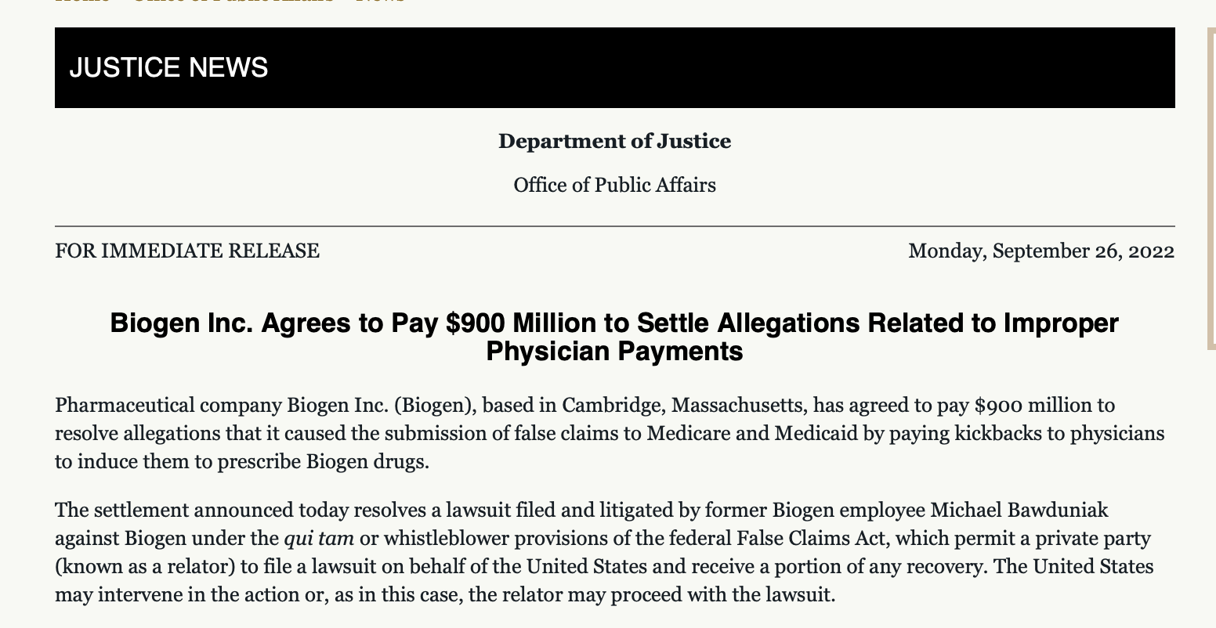
Outcome:
Biogen Settled On Eve Of Trial For $900 million.

Slide 15
What if I cannot follow a docket?
Any Lawyer Can Comment To Provide Perspective On A Case They Are Not Involved In
Lawyers Who Are Involved Can Comment:
To State Client’s Claim or Defense
To Describe Information In A Public Record
To State That An Investigation is Under Way
To Request Help or Assistance
To Describe Scheduling or Steps in Process
To Warn of Danger
To Respond Proportionally To Prejudicial Information Publicized By Others

Slide 16
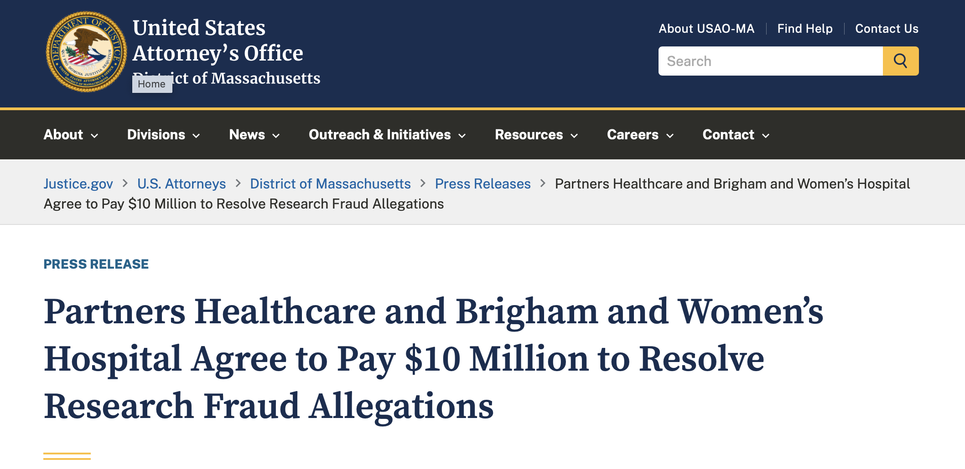
DOJ Press Release

Slide 17
Follow-On Article by Reuters

Slide 18
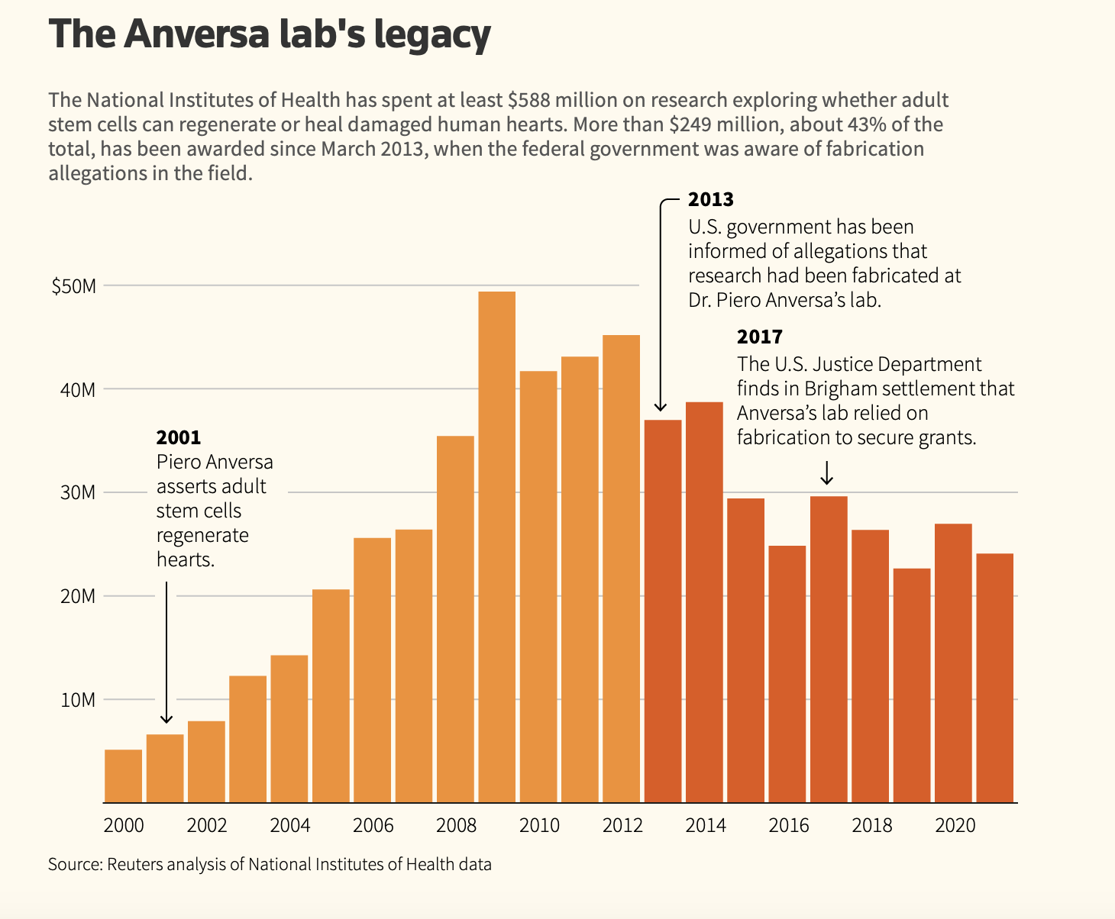
Grant Funding continued…
www.usaspending.gov https://reporter.nih.gov
www.retractionwatchdatabase.com

Slide 19
Questions?

