Slide 1

How to Cover Academic Research Errors and Fraud
Ivan Oransky, MD
Co-Founder, Retraction Watch
Distinguished Journalist In Residence, New York University
Editor in Chief, The Transmitter
@ivanoransky
@retractionwatch

Slide 2
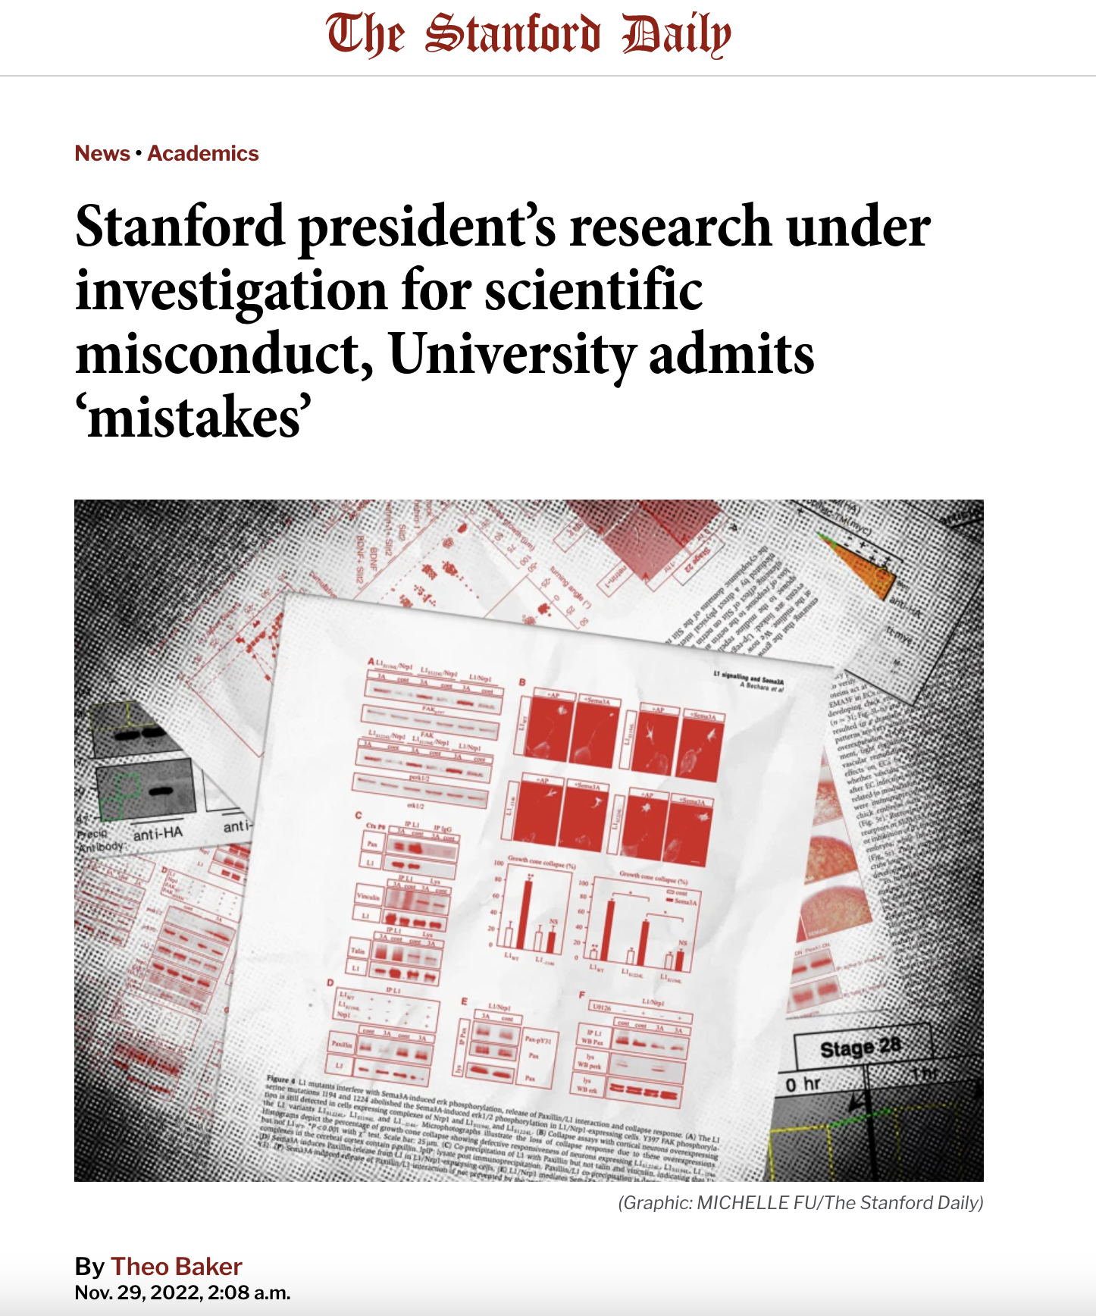
A Blockbuster Case at Stanford

Slide 3
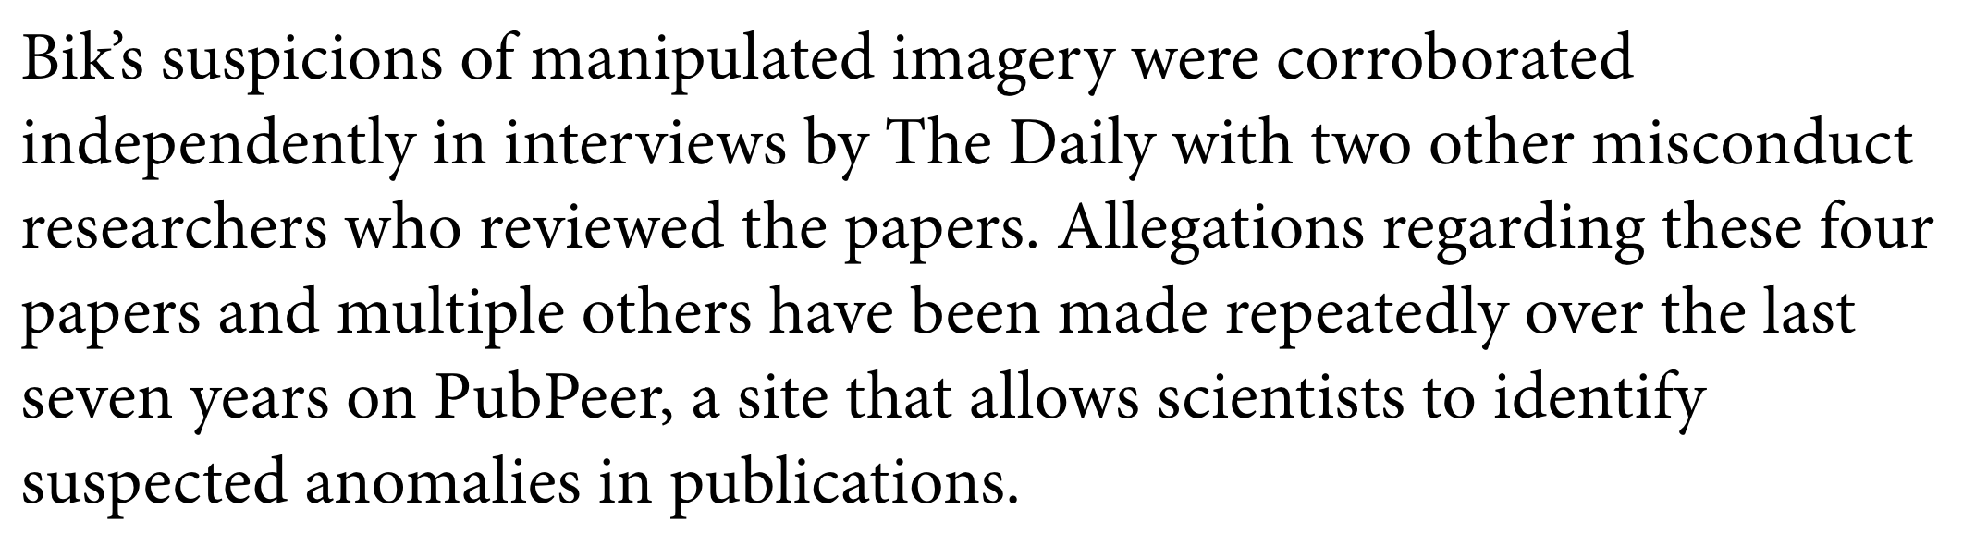
Anatomy of a Scoop

Slide 4

Get to Know PubPeer

Slide 5
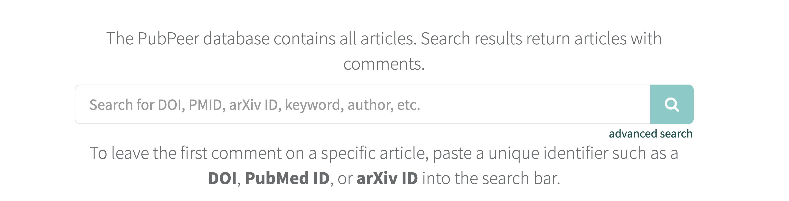
PubPeer.com

Slide 6
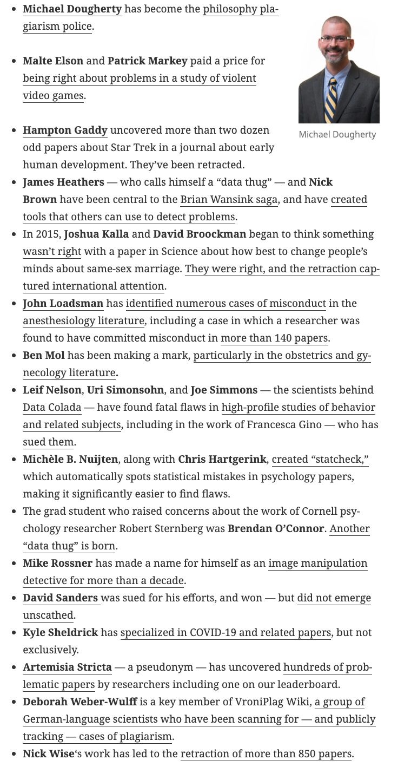
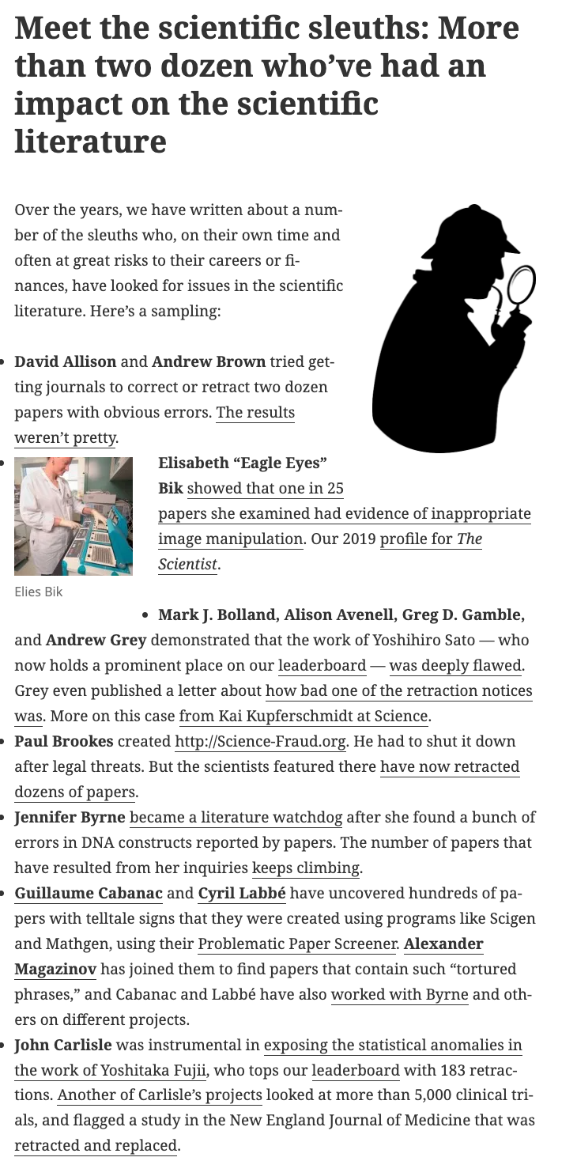
Get to Know the Sleuths

Slide 7
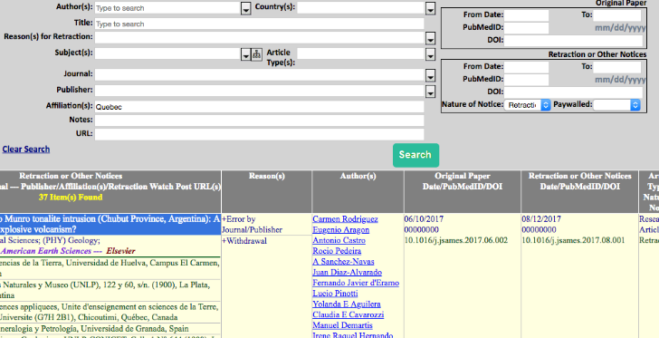
The Retraction Watch Database
retractiondatabase.org

Slide 8
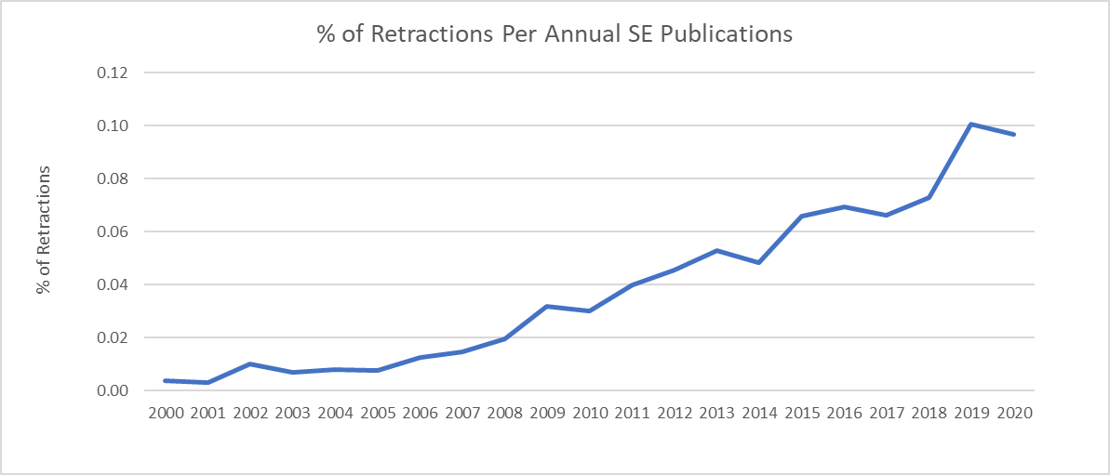
Current Trends
Retractions of a given year’s publications as a percentage of papers published in science and engineering. Retraction data from Retraction Watch Database, overall publication figures via U.S. NSF.

Slide 9
Bad Behavior = Good Story
Duplication (“self-plagiarism”)
Plagiarism
Image Manipulation
Faked Data
Fake Peer Reviews
Publisher Error
Authorship Issues
Legal Reasons
Paper Mills

Slide 10
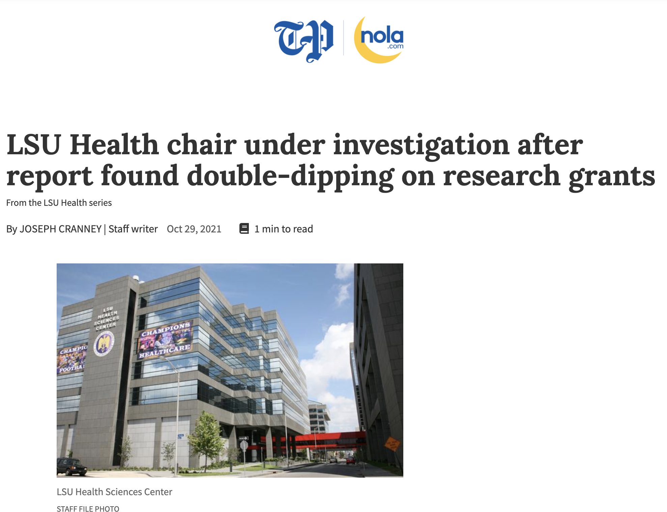
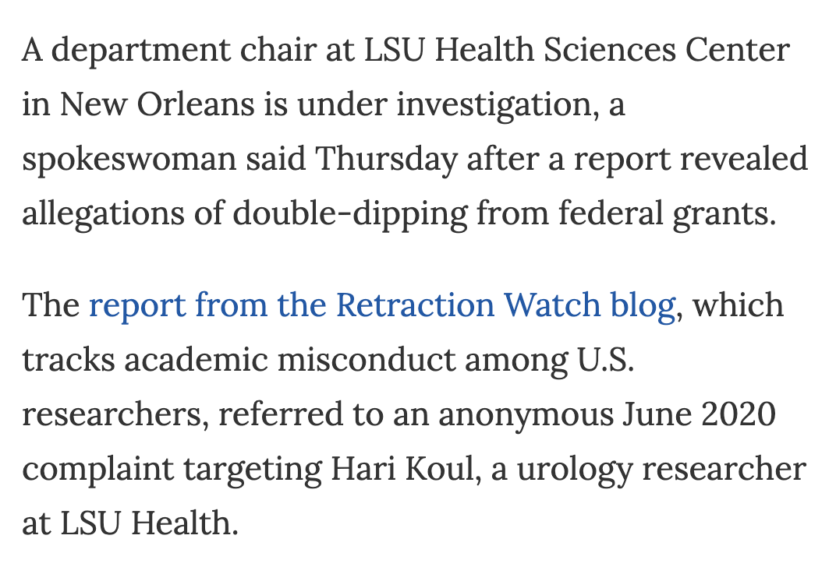
File Public Records Requests

Slide 11
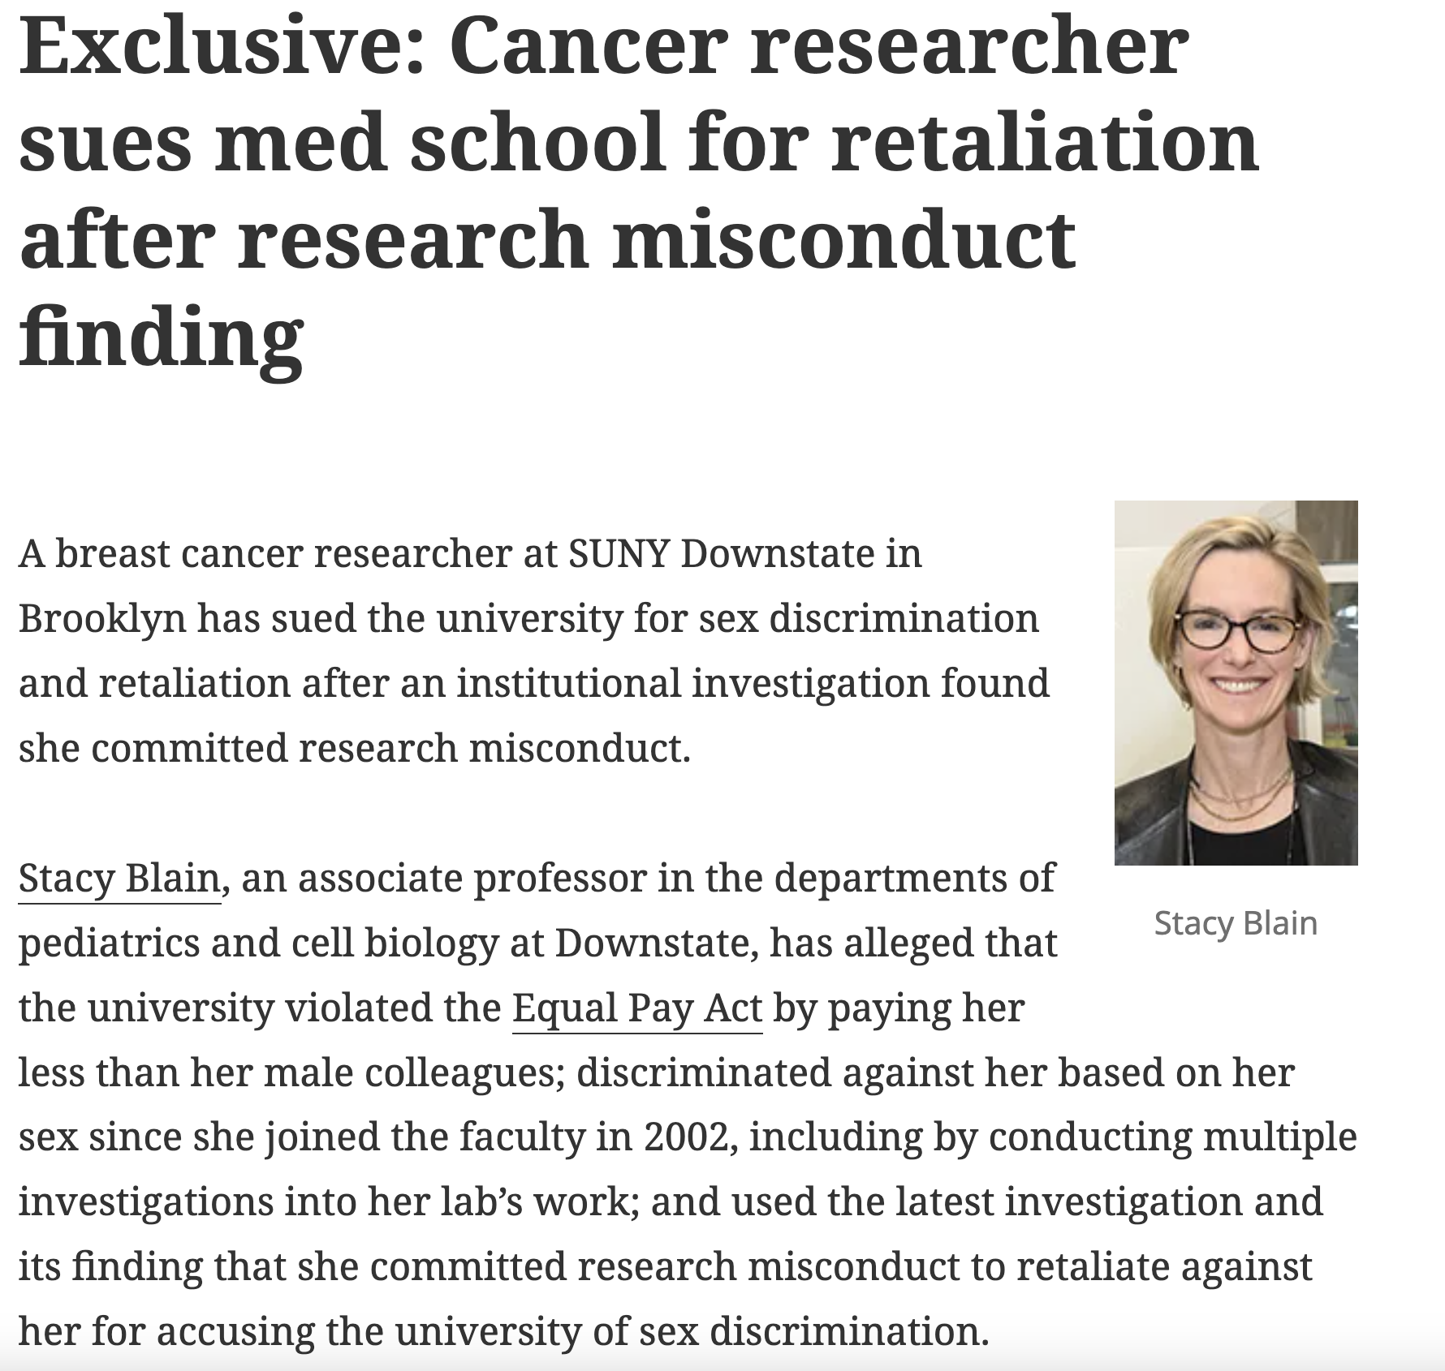
Search Court Records

Slide 12
Contact Info
ivan@retractionwatch.com
http://retractionwatch.com
@retractionwatch

